Slide 1
Normalization

Slide 2
Before the Concept of Normalization
PART (Primary Key) | WAREHOUSE
P0010 | Warehouse A, Warehouse B, Warehouse C
P0020 | Warehouse B, Warehouse D
Really Bad Set-up!
Better, but still flawed!
PART (Primary Key) | WAREHOUSE A | WAREHOUSE B | WAREHOUSE C
P0010 | Yes | No | Yes
P0020 | No | Yes | Yes

Slide 3
Database Normalization
Database normalization is the process of removing redundant data from your tables so as to improve storage efficiency, data integrity, and scalability. In a way Normalization is the process of organizing data in a database.
In the relational model, methods exist for quantifying how efficient a database is. These classifications are called normal forms (or NF), and there are algorithms for converting a given database between them.
Normalization generally involves splitting existing tables into multiple ones, which must be re-joined or linked each time a query is issued.
Normalization is a process that “improves” a database design by generating relations that are of higher normal forms.
The objective of normalization: “to create relations where every dependency is on the key, the whole key, and nothing but the key”.

Slide 4
Why Normalize Tables/Objective
Save typing/storing of repetitive data. This is the process which allows you to winnow out redundant data within database.
Increase flexibility to query, sort, summarize, and group data (Simpler to manipulate data!)
Avoid frequent restructuring of tables and other objects to accommodate new data and avoiding anomalies
Reduce disk space

Slide 5
Why Normalize Tables/Objective
To create a formal framework for analyzing relation schemas based on their keys and on the functional dependencies among their attributes.
To obtain powerful relational retrieval algorithms based on a
collection of primitive relational operators.
To free relations from undesirable insertion, update and deletion
anomalies.
A properly normalized database should have the following characteristics
Scalar values in each fields
Absence of redundancy.
Minimal use of null values.
Minimal loss of information.

Slide 6
Levels of Normalization
Levels of normalization based on the amount of redundancy in the database.
Various levels of normalization are:
First Normal Form (1NF)
Second Normal Form (2NF)
Third Normal Form (3NF)
Boyce-Codd Normal Form (BCNF)
Fourth Normal Form (4NF)
Fifth Normal Form (5NF)
Domain Key Normal Form (DKNF)
Redundancy
Number of Tables
Complexity
Most databases should be 3NF or BCNF in order to avoid the database anomalies.

Slide 7
Levels of Normalization
1NF
2NF
3NF
4NF
5NF
DKNF
Each higher level is a subset of the lower level

Slide 8
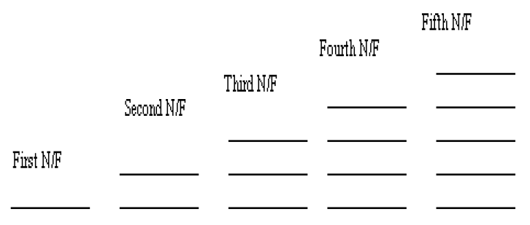
Eliminating Repeating Groups
Non Key attribute fully Functionally dependent on the PK
Eliminate Transitive Dependency on the PK
Remove Multi valued Dependency
Projection Join Dependency

Slide 9
Normalization Level Strength
There is a sequence to normal forms:
1NF is considered the weakest,
2NF is stronger than 1NF,
3NF is stronger than 2NF, and
BCNF is considered the strongest
4NF and 5NF also exists.
Also,
any relation that is in BCNF, is in 3NF;
any relation in 3NF is in 2NF; and
any relation in 2NF is in 1NF.

Slide 10
Normalization Schematic
1NF
a relation in BCNF, is also in 3NF
a relation in 3NF is also in 2NF
a relation in 2NF is also in 1NF
2NF
3NF
BCNF

Slide 11
Reason to have First Normal Form
Domain is atomic if its elements are considered to be indivisible units
Examples of non-atomic domains:
Set of names, composite attributes
Non-atomic values complicate storage and encourage redundant (repeated) storage of data
E.g. Set of accounts stored with each customer, and set of owners stored with each account
Generally we assume all relations are in first normal form

Slide 12
Definition of First Normal Form
A relational schema R is in first normal form if
the domains of all attributes of R are atomic (all underlying domains contain atomic values or single value only) or it also means every entry of the relation (the intersection of a tuple and a column) has at most a single value.
And/or OR no two Rows of data must contain repeating group of information i.e each set of column must have a unique value, such that multiple columns cannot be used to fetch the same row. Each table should be organized into rows, and each row should have a primary key that distinguishes it as unique.

Slide 13
First Normal Form
The following in not in 1NF
EmpNum
EmpPhone
EmpDegrees
123
233-9876
333
233-1231
BA, BSc, PhD
679
233-1231
BSc, MSc
EmpDegrees is a multi-valued field:
employee 679 has two degrees: BSc and MSc
employee 333 has three degrees: BA, BSc, PhD

Slide 14
First Normal Form
EmpNum
EmpPhone
EmpDegrees
123
233-9876
333
233-1231
BA, BSc, PhD
679
233-1231
BSc, MSc
To obtain 1NF relations we must, without loss of information, replace the above with two relations - see next slide

Slide 15
First Normal Form
EmployeeDegree
Employee
EmpNum
EmpDegree
EmpNum
EmpPhone
333
BA
123
233-9876
333
BSc
333
233-1231
333
PhD
679
233-1231
679
BSc
679
MSc
An outer join between Employee and EmployeeDegree will produce the information we saw before

Slide 16
First Normal Form (1NF)
A table is considered to be in 1NF if all the fields contain
only scalar values(atomic) (as opposed to list of values).
Example (Not 1NF)
ISBN
Title
AuName
AuPhone
PubName
PubPhone
Price
0-321-32132-1
Balloon
Sleepy, Snoopy, Grumpy
321-321-1111, 232-234-1234, 665-235-6532
Small House
714-000-0000
$34.00
0-55-123456-9
Main Street
Jones, Smith
123-333-3333, 654-223-3455
Small House
714-000-0000
$22.95
0-123-45678-0
Ulysses
Joyce
666-666-6666
Alpha Press
999-999-9999
$34.00
1-22-233700-0
Visual Basic
Roman
444-444-4444
Big House
123-456-7890
$25.00
Author and AuPhone columns are not scalar
Notes:
Having scalar values also means that all instances of a record type must contain the same number of fields.
A table not in first normal form is called un normalized

Slide 17
1NF - Decomposition
Place all items that appear in the repeating group in a new table
Designate a primary key for each new table produced.
Duplicate in the new table the primary key of the table from which the repeating group was extracted or vice versa.
Example (1NF)
ISBN
AuName
AuPhone
0-321-32132-1
Sleepy
321-321-1111
ISBN
Title
PubName
PubPhone
Price
0-321-32132-1
Snoopy
232-234-1234
0-321-32132-1
Balloon
Small House
714-000-0000
$34.00
0-321-32132-1
Grumpy
665-235-6532
0-55-123456-9
Main Street
Small House
714-000-0000
$22.95
0-55-123456-9
Jones
123-333-3333
0-123-45678-0
Ulysses
Alpha Press
999-999-9999
$34.00
0-55-123456-9
Smith
654-223-3455
1-22-233700-0
Visual Basic
Big House
123-456-7890
$25.00
0-123-45678-0
Joyce
666-666-6666
1-22-233700-0
Roman
444-444-4444
Notes:
1. The designated key will be the primary key of the original table concatenated with one or more data items from the new table.
For the first table the primary key is ISBN
For the second table the primary key is ISBN + Author Name

Slide 18
Keys
Superkey: A super key is a set of one or more attributes that taken collectively allows us to identify uniquely an entity or a table. Super Key is a set of properties within a table; it specially identifies each record in a table.
OR
A super key refers to the set of all those keys that help us uniquely identify all the rows present in a table. It means that all of these columns present in a table that can identify the columns of that table uniquely act as the super keys.
For Example, ALL ATTRIBUTES IN A TABLE
Note:
Adding zero or more attributes to the candidate key generates the super key.
A candidate key is a super key but vice versa is not true.
Super Key values may also be NULL.

Slide 19
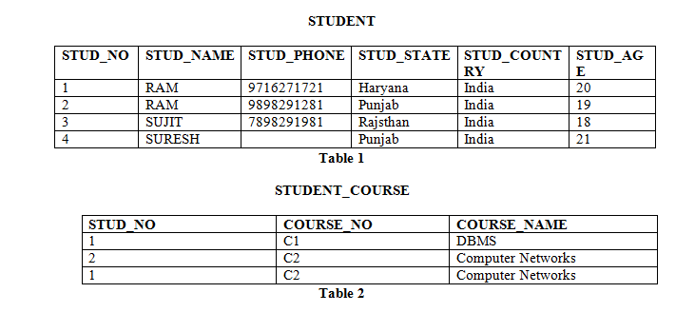

Slide 20
Candidate Key: Any subsets of the attributes of a superkey that is also a super key and is not reducible to another superkey can be a candidate key.
Candidate key is a unique case of super key. A super key is a candidate key’s superset.
The minimal set of attribute which can uniquely identify a tuple is known as candidate key. It is a subset of the super key For Example, STUD_NO, STUD_NAME in STUDENT relation.

Slide 21
For Example, STUD_NO in STUDENT relation.
It is a minimal super key.
It is a super key with no repeated data called a candidate key.
The minimal set of attributes that can uniquely identify a record.
It must contain unique values.
It cannot contain NULL values.
Every table must have at least a single candidate key.**
A table can have multiple candidate keys but only one primary key.**
The value of the Candidate Key is unique and may be null for a tuple.
There can be more than one candidate key in a relationship.

Slide 22
STUD_NO | SNAME | ADDRESS | PHONE
1 | Shyam | Delhi | 123456789
2 | Rakesh | Kolkata | 223365796
3 | Suraj | Delhi | 175468965

Slide 23
Alternate Key: The candidate key other than the primary key is called an alternate key. All the keys which are not primary keys are called alternate keys.
It is a secondary key.
It contains two or more fields to identify two or more records. These values are repeated.
Eg:- SNAME, and ADDRESS is Alternate keys
STUD_NO | SNAME | ADDRESS | PHONE
1 | Shyam | Delhi | 123456789
2 | Rakesh | Kolkata | 223365796
3 | Suraj | Delhi | 175468965
Consider the table shown above. STUD_NO, as well as PHONE both,
are candidate keys for relation STUDENT but PHONE will be an alternate key
(only one out of many candidate keys).

Slide 24
Primary Key: It is selected arbitrarily from the set of candidate keys to be used in an index for that table.
For EX Student_no
It is a unique key.
It can identify only one tuple (a record) at a time.
It has no duplicate values, it has unique values.
It cannot be NULL.
Primary keys are not necessarily to be a single column; more than one column can also be a primary key for a table
Note:
There can be more than one candidate key in a relation out of which one can be chosen as primary key. For Example, STUD_NO as well as STUD_PHONE both are candidate keys for relation STUDENT but STUD_NO can be chosen as primary key (only one out of many candidate keys). Exception is Composite keys: Weak state

Slide 25
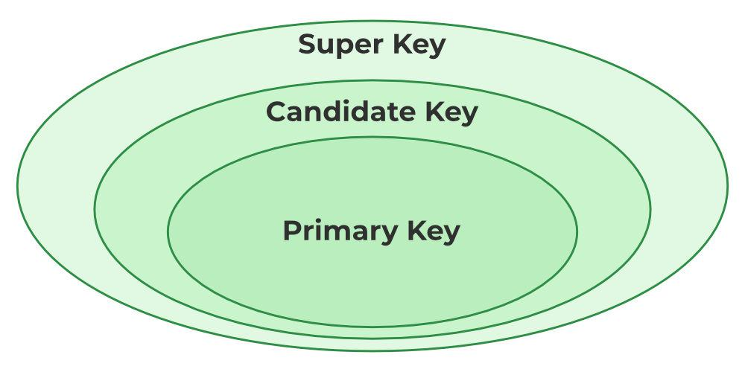

Slide 26
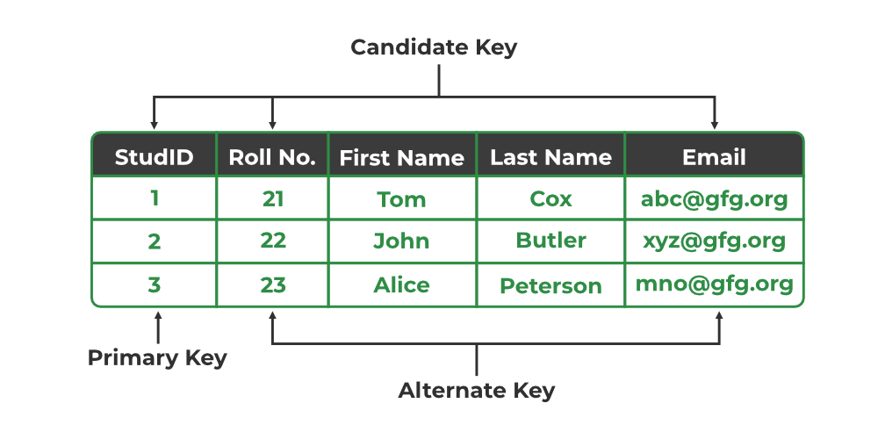

Slide 27
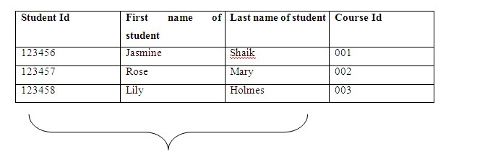
Composite key
Composite Key has two or more properties which specially identifies the occurrence of an entity.

Slide 28
Foreign Key
In a relationship between two tables, a primary key of one table is referred as a foreign key in another table. Foreign key can have duplicate values in it and can also keep null values if column is defined to accept nulls.
Natural Keys: A natural key is a key composed of columns that actually have a logical relationship to other columns within a table. For example, if we use Student_Id, Student_Name and Father_Name columns to form a key then it would be “Natural Key” because there is definitely a relationship between these columns and other columns that exist in table. Natural keys are often called “Business Key ” or “Domain Key”. Surrogate Key: Surrogate key is an artificial key that is used to uniquely identify the record in table. For example, in SQL Server or Sybase database system contain an artificial key that is known as “Identity”. Surrogate keys are just simple sequential number. Surrogate keys are only used to act as a primary key.

Slide 29
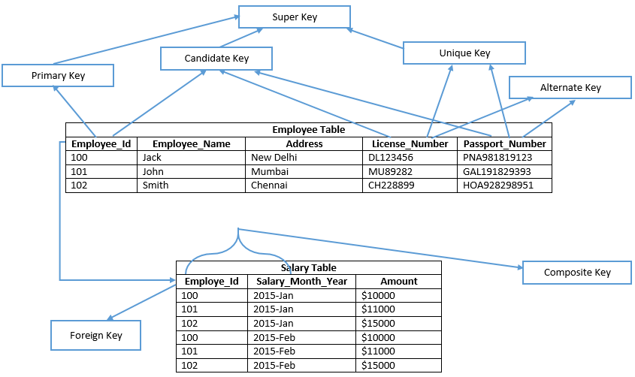

Slide 30
Functional Dependencies
In a relational database management, functional dependency is a concept that specifies the relationship
between two sets of attributes where one attribute determines the value of another attribute. It is
denoted as X → Y, where the attribute set on the left side of the arrow, X is called Determinant,
and Y is called the Dependent.
If one set of attributes in a table determines another set of attributes in the table, then the second set of
attributes is said to be functionally dependent on the first set of attributes.
We say an attribute, B, has a functional dependency on another attribute, A, if for any two records,
which have the same value for A, then the values for B in these two records must be the same. We
illustrate this as: A → B
Note:
A functional dependency is a generalization of the notion of a key.
Notes:
Notes to Instructor: Need more rigor in the functional dependencies. With a few examples. May be create a class assignment for functional dependencies.

Slide 31
Functional Dependencies (Cont.)
Let R be a relation schema
α ⊆ R and β ⊆ R
The functional dependency
α → β holds on R if and only if for any legal relations r(R), whenever any two tuples t₁ and t₂ of r agree on the attributes α, they also agree on the attributes β. That is,
t₁[α] = t₂ [α] ⇒ t₁[β ] = t₂ [β ]
Example: Consider r(A,B) with the following instance of r.
A B
On this instance, A → B does NOT hold, but B → A does hold.
4
1 5
3 7

Slide 32
Functional Dependencies (Cont.)
K is a superkey for relation schema R if and only if K → R
K is a candidate key for R if and only if
K → R, and
for no α ⊂ K, α → R
Functional dependencies allow us to express constraints that cannot be expressed using superkeys. Consider the schema:
Loan-info-schema = (customer-name, loan-number, branch-name, amount).
We expect this set of functional dependencies to hold:
loan-number → amount loan-number → branch-name
but would not expect the following to hold:
loan-number → customer-name**
[** Something related to uniqueness]

Slide 33
roll_no | name | dept_name | dept_building
42 | abc | CO | A4
43 | pqr | IT | A3
44 | xyz | CO | A4
45 | xyz | IT | A3
46 | mno | EC | B2
47 | jkl | ME | B2

Slide 34
From the above table we can conclude some valid functional dependencies:
roll_no → { name, dept_name, dept_building },→ Here, roll_no can determine values of fields name, dept_name and dept_building, hence a valid Functional dependency
roll_no → dept_name , Since, roll_no can determine whole set of {name, dept_name, dept_building}, it can determine its subset dept_name also.
dept_name → dept_building , Dept_name can identify the dept_building accurately, since departments with different dept_name will also have a different dept_building
More valid functional dependencies: roll_no → name, {roll_no, name} ⇢ {dept_name, dept_building}, etc.

Slide 35
Here are some invalid functional dependencies:
name → dept_name Students with the same name can have different dept_name, hence this is not a valid functional dependency.
dept_building → dept_name There can be multiple departments in the same building. Example, in the above table departments ME and EC are in the same building B2, hence dept_building → dept_name is an invalid functional dependency.
More invalid functional dependencies: name → roll_no, {name, dept_name} → roll_no, dept_building → roll_no, etc.

Slide 36
Trivial Functional Dependencies
A functional dependency is trivial if it is satisfied by all instances of a relation
Definition: A trivial functional dependency occurs when you describe a functional dependency of an attribute on a collection of attributes that includes the original attribute. This type of functional dependency is called trivial because it can be derived from common sense. It is obvious that if you already know the value of B, then the value of B can be uniquely determined by that knowledge.
E.g.
customer-name, loan-number → customer-name
customer-name → customer-name
In general, α → β is trivial if β ⊆ α

Slide 37
Since by definition an FD is a relationship between an attribute "Y“ (dependent) and a determinant (1 or more other attributes) "X" such that for a given value of a determinant the value of the attribute is uniquely defined.
X is a determinant
X determines Y
Or “Y is functionally dependent on X”
Which is denoted as “X → Y”
Then X →Y is trivial if Y ⊆ X
Trivial Functional Dependency The FD X→Y is trivial if set {Y} is a subset of set {X} Examples: If A and B are attributes of R, {A}→{A} {A,B} →{A} {A,B} →{B} {A,B} →{A,B} are all trivial FDs and will not contribute to the evaluation of normalization.

Slide 38
Rules for Functional Dependency-
Rule-01:
A functional dependency X → Y will always hold if all the values of X are unique (different) irrespective of the values of Y.
Rule-02:
A functional dependency X → Y will always hold if all the values of Y are same irrespective of the values of X.
Rule-03:
For a functional dependency X → Y to hold, if two tuples in the table agree on the value of attribute X, then they must also agree on the value of attribute Y.
Rule-04:
For a functional dependency X → Y, violation will occur only when for two or more same values of X, the corresponding Y values are different.

Slide 39
Functional Dependencies
Examples 1
ISBN
Title
Price
Table Scheme: {ISBN, Title, Price}
Functional Dependencies: {ISBN} → {Title}
{ISBN} → {Price}
0-321-32132-1
Balloon
$34.00
0-55-123456-9
Main Street
$22.95
0-123-45678-0
Ulysses
$34.00
1-22-233700-0
Visual Basic
$25.00

Slide 40
Functional Dependencies
Example 2
Table Scheme: {PubID, PubName, PubPhone}
Functional Dependencies: {PubId} → {PubPhone}
{PubId} → {PubName}
{PubName, PubPhone} → {PubID}
PubID
PubName
PubPhone
1
Big House
999-999-9999
2
Small House
123-456-7890
3
Alpha Press
111-111-1111
Example 3
AuID
AuName
AuPhone
Table Scheme: {AuID, AuName, AuPhone}
Functional Dependencies: {AuId} → {AuPhone}
{AuId} → {AuName}
{AuName, AuPhone} → {AuID}
1
Sleepy
321-321-1111
2
Snoopy
232-234-1234
3
Grumpy
665-235-6532
4
Jones
123-333-3333
5
Smith
654-223-3455
6
Joyce
666-666-6666
7
Roman
444-444-4444

Slide 41
FD – Example
Database to track reviews of papers submitted to an academic conference. Prospective authors submit papers for review and possible acceptance in the published conference proceedings. Details of the entities
Author information includes a unique author number, a name, a mailing address, and a unique (optional) email address.
Paper information includes the primary author, the paper number, the title, the abstract, and review status (pending, accepted,rejected)
Reviewer information includes the reviewer number, the name, the mailing address, and a unique (optional) email address
A completed review includes the reviewer number, the date, the paper number, comments to the authors, comments to the program chairperson, and ratings (overall, originality, correctness, style, clarity)

Slide 42
FD – Example
Functional Dependencies
AuthNo → AuthName, AuthEmail, AuthAddress
AuthEmail → AuthNo
PaperNo → Primary-AuthNo, Title, Abstract, Status
RevNo → RevName, RevEmail, RevAddress
RevEmail → RevNo
RevNo, PaperNo → AuthComm, Prog-Comm, Date, Rating1, Rating2, Rating3, Rating4, Rating5

Slide 43
Let R be NewStudent (stuId, lastName, major, credits, status, socSecNo)
FDs in R include
{stuId}→{lastName}, but not the reverse
{stuId} →{lastName, major, credits, status, socSecNo, stuId}
{socSecNo} →{stuId, lastName, major, credits, status, socSecNo}
{credits}→{status}, but not {status}→{credits}
ZipCode→AddressCity
16652 is Huntingdon’s ZIP
ArtistName→BirthYear
Picasso was born in 1881
Autobrand→Manufacturer, Engine type
Pontiac is built by General Motors with gasoline engine
Author, Title→PublDate
Shakespeare’s Hamlet was published in 1600

Slide 44
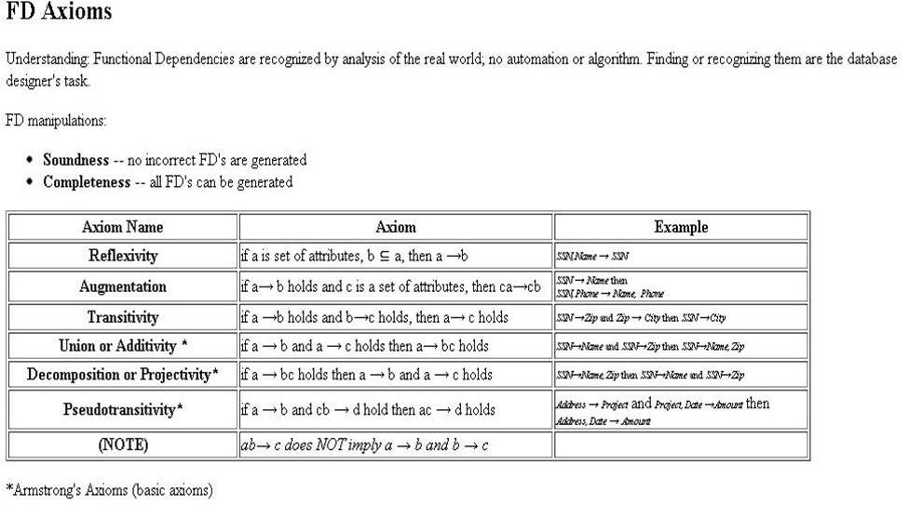

Slide 45
Closure of a Set of Functional Dependencies
Given a set F set of functional dependencies, there are certain other functional dependencies that are logically implied by F.
E.g. If A → B and B → C, then we can infer that A → C
The set of all functional dependencies logically implied by F is the closure of F.
We denote the closure of F by F⁺.
We can find all of F⁺ by applying Armstrong’s Axioms:
if β ⊆ α, then α → β (reflexivity)
if α → β, then γ α → γ β (augmentation)
if α → β, and β → γ, then α → γ (transitivity)
These rules are
sound (generate only functional dependencies that actually hold) and
complete (generate all functional dependencies that hold).

Slide 46
Procedure for Computing F⁺
To compute the closure of a set of functional dependencies F:
F⁺ = F repeat for each functional dependency f in F⁺ apply reflexivity and augmentation rules on f add the resulting functional dependencies to F⁺ for each pair of functional dependencies f₁and f₂ in F⁺ if f₁ and f₂ can be combined using transitivity then add the resulting functional dependency to F⁺ until F⁺ does not change any further
NOTE: We will see an alternative procedure for this task later

Slide 47
Closure of Functional Dependencies (Cont.)
We can further simplify manual computation of F⁺ by using the following additional rules (Armstrong’s axioms) to get a steady result.
If α → β holds and α → γ holds, then α → β γ holds (union)
If α → β γ holds, then α → β holds and α → γ holds (decomposition)
If α → β holds and γ β → δ holds, then α γ → δ holds (pseudotransitivity)
The above rules can be inferred from Armstrong’s axioms.

Slide 48
Closure of Attribute Sets
Given a set of attributes α, define the closure of α under F (denoted by α⁺) as the set of attributes that are functionally determined by α under F: α → β is in F⁺ ⬄ β ⊆ α⁺
Algorithm to compute α⁺, the closure of α under F result := α; while (changes to result) do for each β → γ in F do begin if β ⊆ result then result := result ∪ γ end

Slide 49
Example
R = (A, B, C, G, H, I) F = { A → B A → C CG → H CG → I B → H}
some members of F⁺
A → H
by transitivity from A → B and B → H
AG → I
by augmenting A → C with G, to get AG → CG and then transitivity with CG → I
CG → HI
from CG → H and CG → I : “union rule” can be inferred from
definition of functional dependencies, or
Augmentation of CG → I to infer CG → CGI, augmentation of CG → H to infer CGI → HI, and then transitivity

Slide 50
Provided a relation R {A,B, C,D,E,H} Find F +
F = { A → C, AC → D, E → AD, E → H}
F + = { A → C, AC → D, E → AD, E → H
E → A, E → D :DECOMPOSITION OF E → AD
E → ADH :UNION OF E → AD & E → H
A → D :PSEUDOTRANSITIVITY, A → C & AC → D |= AA → D |= A → D
E → C : TRANSITIVITY, E → A & A → C
}

Slide 51
Provided a relation G {A,C,D,E,H} Find G +
G = { A → CD, E → AH }
SOLN?

Slide 52
G+ = { A → CD, E → AH
A → C, A → D :DECOMPOSITION, A → CD
E → A, E → H :DECOMPOSITION , E → AH
E → C :TRANSITIVITY E → A & A→ C
E → D : TRANSITIVITY E → A & A → D
E → ADH :UNION E → A, E → D AND E → H
E → AD :UNION E → A, E → D
AC → D :AGUMENTATION OF A → D
}

Slide 53
Given the relation schema R(A,B,C,D) and
the FDs
F = ( A → B, BC → D).
Find the closure of F
SOLUTION ?

Slide 54
Solution:
F+ = { A → B, BC → D
AC → D : PSEUDOTRANSITIVITY
}

Slide 55
Show that F |= XY → Q where F = { XY → W, Y → Z, WZ → P, WP → QR, Q → X }
by using inference rules
SOLUTION?

Slide 56
XY → W, WZ → P |= XYZ → P by Pseudotransitivity
Y → Z, XYZ → P |= XY → P by Pseudotransitivity (reduce YY to Y)
WP → QR |= WP → Q, WP → R by decomposition
WP → Q, XY → W |= XYP → Q by Pseudotransitivity
XY → P, XYP → Q |= XY → Q by Pseudotransitivity (reduce XY XY to XY)

Slide 57
Example of Attribute Set Closure
R = (A, B, C, G, H, I)
F = {A → B A → C CG → H CG → I B → H}
(AG)⁺
1. result = AG
2. result = ABCG (A → C and A → B and A ⊆ AG)
3. result = ABCGH (CG → H and CG ⊆ AGBC)
4. result = ABCGHI (CG → I and CG ⊆ AGBCH)
Is AG a candidate key?
Is AG a super key?
Does AG → R? == Is (AG)⁺ ⊇ R
Is any subset of AG a superkey?
Does A → R? == Is (A)⁺ ⊇ R
Does G → R? == Is (G)⁺ ⊇ R

Slide 58
Uses of Attribute Closure
There are several uses of the attribute closure algorithm:
Testing for superkey:
To test if α is a superkey, we compute α^{+,} and check if α⁺ contains all attributes of R.
Testing functional dependencies
To check if a functional dependency α → β holds (or, in other words, is in F⁺), just check if β ⊆ α⁺.
That is, we compute α⁺ by using attribute closure, and then check if it contains β.
Is a simple and cheap test, and very useful
Computing closure of F
For each γ ⊆ R, we find the closure γ⁺, and for each S ⊆ γ⁺, we output a functional dependency γ → S.

Slide 59
Algorithm : Finding a Key K for R Given a set F of Functional Dependencies
Input: A universal relation R and a set of functional dependencies F on the attributes of R.
Step 1 : Set K := R.
Step 2 : For each attribute A in K compute (K - A)+ with
respect to F; If (K - A)+ contains all the attributes
in R, then set K := K - {A};
Step 3 : Repeat step 2 until no more attributes are deleted
from K.
Step 4 : The set K is the key of the relation.

Slide 60
Given the relation R(A,B,C,D) and the set
F = {AB → C, B→ D, D → B} of functional dependencies, find the candidate keys of the
relation.
K = {A, B, C ,D}
{K – A}+ = {B, C, D}
{K – A}+ ≠ R (A cannot be added by any other FD, hence A cannot be removed from K )
K = {A, B, C ,D}
{K – B}+ = {A, B, C, D} (B is added by the FD: D → B)
{K – B}+ = R (hence Remove B from K )
K = {A, B, C, D}
{K – C} = {A, D}
{K – C}+ = {A, B, C, D} (B is added by the FD: D → B, C is added by the FD AB → C)
{K – C}+ = R (hence Remove C from K)
K = {A, B, C, D}
{K – D}+ = {A}
{K – D}+ ≠ R (hence D cannot be removed from K)
The candidate key I (A,D)

Slide 61
Decomposition
Decompose the relation schema Lending-schema into:
Branch-schema = (branch-name, branch-city,assets)
Loan-info-schema = (customer-name, loan-number, branch-name, amount)
All attributes of an original schema (R) must appear in the decomposition (R₁, R₂):
R = R₁ ∪ R₂
Lossless-join decomposition. For all possible relations r on schema R
r = ∏_{R1} (r) ∏_{R2} (r)

Slide 62
Example of Non Lossless-Join Decomposition
Decomposition of R = (A, B) R₁ = (A) R₂ = (B)
A
B
A
B
α
α
β
1
2
1
α
β
1
2
∏_{A}(r)
∏_{B(r)}
r
∏_{A} (r) ∏_{B} (r)
A
B
α
α
β
β
1
2
1
2

Slide 63
Lossy decomposition
Lossless Decomposition

Slide 64
Goal — Devise a Theory for the Following
Decide whether a particular relation R is in “good” form.
In the case that a relation R is not in “good” form, decompose it into a set of relations {R₁, R₂, ..., R_{n}} such that
each relation is in good form
the decomposition is a lossless-join decomposition
Our theory is based on:
functional dependencies
multivalued dependencies

Slide 65
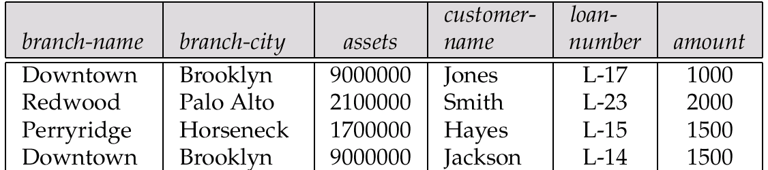
Example
Consider the relation schema: Lending-schema = (branch-name, branch-city, assets, customer-name, loan-number, amount)
Redundancy:
Data for branch-name, branch-city, assets are repeated for each loan that a branch makes
Wastes space
Complicates updating, introducing possibility of inconsistency of assets value
Null values
Cannot store information about a branch if no loans exist
Can use null values, but they are difficult to handle.

Slide 66
Second Normal Form (2NF)
For a table to be in 2NF, there are two requirements
The database is in first normal form
All nonkey attributes in the table are functionally dependent on the entire primary key
Note: Remember that we are dealing with non-key attributes
In a table, if attribute B is functionally dependent on A, but is not functionally dependent on a proper subset of A, then B is considered fully functionally dependent on A and not on the other partial composition of A that makes it a composite primary key.
Where as, in a 2NF table, all non-key attributes cannot be dependent on a subset of the primary key.
Note that if the primary key is not a composite key, all non-key attributes are always fully functional dependent on the primary key.
A table that is in 1st normal form and contains only a single key as the primary key is automatically in 2nd normal form.

Slide 67
Second Normal Form Decomposition Process
If a data item is fully functionally dependent on only a part of the primary key, move that data item and that part of the primary key to a new table.
If other data items are functionally dependent on the same part of the key, place them in the new table also
Make the partial primary key copied from the original table as the primary key for the new table. Place all items that appear in the repeating group in a new table

Slide 68
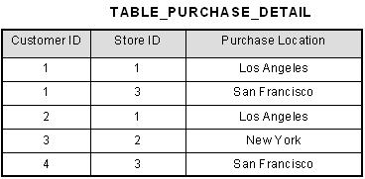
2NF - Decomposition
Consider the following example:
This table has a composite primary key [Customer ID, Store ID].
The non-key attribute is [Purchase Location].
In this case, [Purchase Location] only depends on [Store ID], which is only part of the primary key. Therefore, this table does not satisfy second normal form.

Slide 69
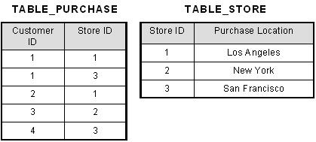
To bring this table to second normal form, we break the table into two tables, and now we have the following:
What we have done is that we have removed the partial functional dependency that we initially had.
Now, in the table [TABLE_STORE], the column [Purchase Location] is fully dependent on the primary key of that table, which is [Store ID].
Its in 2NF now

Slide 70
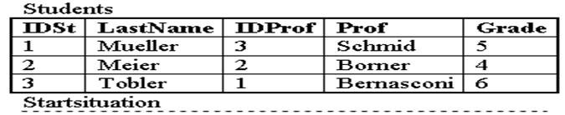
Second normal form 2NF Example Contd:
A university uses the following relation:
Student(IDSt, StudentName, IDProf, ProfessorName, Grade)
The attributes IDSt and IDProf are the identification keys. All attributes are single valued (1NF).

Slide 71
The following functional dependencies exist: 1. The attribute ProfessorName is functionally dependent on attribute IDProf (IDProf --> ProfessorName) 2. The attribute StudentName is functionally dependent on IDSt (IDSt --> StudentName) 3. The attribute Grade is fully functional dependent on IDSt and IDProf (IDSt, IDProf --> Grade)
The table in this example is in first normal form (1NF) since all attributes are single valued.
But it is not yet in 2NF.
If student 1 leaves university and the tuple is deleted, then we loose all information about professor Schmid, since this attribute is fully functional dependent on the primary key IDSt.
[ANOMALY DISCUSSED LATER]

Slide 72
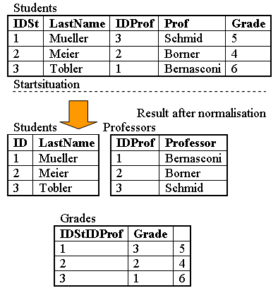
To solve this problem, we must create a new table Students with ID and std name and another table Professor with the attribute Professor (the name) and the key IDProf.
The third table Grade is necessary for combining the two relations Student and Professor and to manage the grades.
Besides the grade it contains only the two IDs of the student and the professor.
If now a student is deleted, we do not loose the information about the professor.

Slide 73
2NF Condition Check
Example 1 (Not 2NF)
Scheme → {Title, PubId, AuId, Price, AuAddress}
Key → {Title, PubId, AuId}
{Title, PubId, AuID} → {Price}
{AuID} → {AuAddress}
AuAddress does not belong to a key
AuAddress functionally depends on AuId which is a subset of a key

Slide 74
2NF Condition Check Contd..
Example 2 (Not 2NF)
Scheme → {City, Street, HouseNumber, HouseColor, CityPopulation}
key → {City, Street, HouseNumber}
{City, Street, HouseNumber} → {HouseColor}
{City} → {CityPopulation}
CityPopulation does not belong to any key.
CityPopulation is functionally dependent on the City which is a proper subset of the key
Example 3 (Not 2NF)
Scheme → {studio, movie, budget, studio_city}
Key → {studio, movie}
{studio, movie} → {budget}
{studio} → {studio_city}
studio_city is not a part of a key
studio_city functionally depends on studio which is a proper subset of the key

Slide 75
2NF – Decomposition For Prev Examples
Example 1 (Convert to 2NF)
Old Scheme → {Title, PubId, AuId, Price, AuAddress}
New Scheme → {Title, PubId, AuId, Price}
New Scheme → {AuId, AuAddress}

Slide 76
2NF - Decomposition
Example 2 (Convert to 2NF)
Old Scheme → {Studio, Movie, Budget, StudioCity}
New Scheme → {Movie, Studio, Budget}
New Scheme → {Studio, City}
Example 3 (Convert to 2NF)
Old Scheme → {City, Street, HouseNumber, HouseColor, CityPopulation}
New Scheme → {City, Street, HouseNumber, HouseColor}
New Scheme → {City, CityPopulation}

Slide 77
What is the crux of the second normal form then?

Slide 78
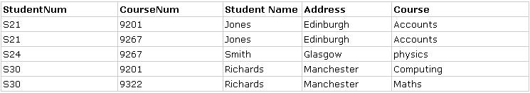
Anomalies
Anomalies are inconvenient or error-prone situation arising when we process the tables. There are three types of anomalies:
Update Anomalies
Delete Anomalies
Insert Anomalies
Update Anomalies
An Update Anomaly exists when one or more instances of duplicated data is updated, but not all. For example, consider Jones is changing address & you need to update all instances of Jones's address.

Slide 79
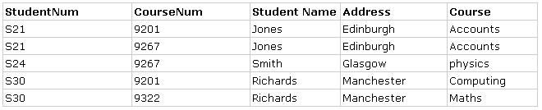
Delete Anomalies
A Delete Anomaly exists when certain attributes are lost because of the deletion of other attributes. For example, consider what happens if Student S30 is the last student to leave the course - All information about the course is lost. (Which course? How does the leaving of Jones, Smith and Richards differ?)

Slide 80

Insert Anomalies
An Insert Anomaly occurs when certain attributes cannot be inserted into the database without the presence of other attributes. For example this is the converse of delete anomaly: We can't add a new course unless we have at least one student enrolled on the course.

Slide 81
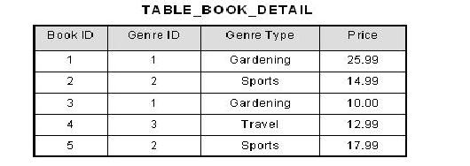
3rd Normal Form Definition
A database is in third normal form if it satisfies the following conditions:
It is in second normal form
There is no transitive functional dependency for non prime attribute.
By transitive functional dependency, we mean we have the following relationships in the table: A is functionally dependent on B, and B is functionally dependent on C. In this case, C is transitively dependent on A via B.
3rd Normal Form Example
Consider the following example:

Slide 82
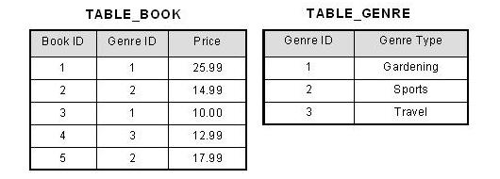
In the table able, [Book ID] determines [Genre ID], and [Genre ID] determines [Genre Type]. Therefore, [Book ID] determines [Genre Type] via [Genre ID] and we have transitive functional dependency, and this structure does not satisfy third normal form.
To bring this table to third normal form, we split the table into two as follows:
Now all non-key attributes are fully functional dependent only on the primary key. In [TABLE_BOOK], both [Genre ID] and [Price] are only dependent on [Book ID]. In [TABLE_GENRE], [Genre Type] is only dependent on [Genre ID].

Slide 83
Ex 2 Look at the table given below for the relation CANDIDATE:
CAND_NO | CAND_NAME | CAND_STATE | CAND_COUNTRY | CAND_AGE
1 | TINA | MAHARASHTRA | INDIA | 18
2 | ANJALI | RAJASTHAN | INDIA | 17
3 | RAHUL | RAJASTHAN | INDIA | 19
In the relation CANDIDATE given above:
Functional dependency Set:
{CAND_NO -> CAND_NAME, CAND_NO ->CAND_STATE, CAND_STATE -> CAND_CUNTRY,
CAND_NO -> CAND_AGE}
So, Candidate key here would be:
{CAND_NO}
For the relation given here in the table, CAND_NO -> CAND_STATE and CAND_STATE -> CAND_COUNTRY are
actually true.
Thus, CAND_COUNTRY depends transitively on CAND_NO.
This transitive relation violates the rules of being in the 3NF. So, if we want to convert it into the third normal form,
then we have to decompose the relation CANDIDATE (CAND_NO, CAND_NAME, CAND_STATE,
CAND_COUNTRY, CAND_AGE) as:
CANDIDATE (CAND_NO, CAND_NAME, CAND_STATE, CAND_AGE)
STATE_COUNTRY (STATE, COUNTRY)

Slide 84
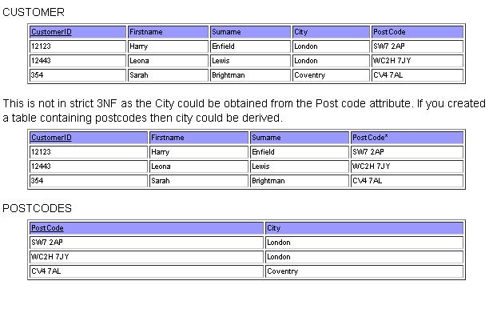
Ex3:
3NF Revisited

Slide 85
Def: 1. It should be in 3nf and 2. for every non-trivial FD X → A, X is a super key. On the basis of this another def of 3nf is: A relation is in 3NF if for every non-trivial FD X → A, X is a superkey or A is part of some key
BCNF : Boyce-Codd Normal Form

Slide 86
If a relational schema is in 3NF then all redundancy based on functional dependency has been removed.
Although other types of redundancy may still exist. A relational schema R is in Boyce–Codd normal form if and only if for every one of its dependencies X → Y, at least one of the following conditions hold:
X → Y is a trivial functional dependency (Y ⊆ X)
X is a super key for schema R

